Slide 1

PMI GoGreen
General information
Configuration & Integration
Step-by-step guidance

Slide 2
PMI GoGreen – General info
PMI GoGreen with R&P and Planning
Allow the client to have cost per resource in the GG cockpits and submit a forecast to PMI Planning
PMI GoGreen with R&P
The client will need to enter the unit price manually to have the cost in the GG cockpits
PMI GoGreen standalone
The client will need to enter the unit price manually to have the cost in the GG cockpits
- Note: Require an import on room revenue, GN/RN and OTB figures

Slide 3
PMI GoGreen – General info
PMI GoGreen categories
Waste
mixed municipal waste
Paper and cardboard
Glass
plastics
metals
biodegradable kitchen and canteen waste
Garden and park waste
Fluorescent tubes and other mercury-containing wastes
batteries
Sludges from in-house wastewater treatment
toner waste
Edible oils and fats
Oils and fats (Mainternence)
bulky waste
Paints, inks, adhesives and resins containing dangerous substances
drug
Used electronic devices & IT
Electronic devices with coolant
LED
Towels & linen
Towels Large
Towels Small
Towels Lux Large
Towels Lux Small
Duvet cover Small
Duvet cover Large
Bath mat
Duvet cover - child
Bed Sheets Large
Bed Sheets Small
Pillowcases Large
Pillowcases Small
Hand cloths
Bathrobes
Energy
Electricity
District heating
Cooling
Gas
Oil
Solar
Water
Food waste
Production
Inventory
Guest plate
Buffet
Canteen & staff
Meeting & event
Chemicals
Red
Green
Yellow
Where a data integration is not available, the data can be manually entered into PMI GoGreen on all resources

Slide 4


Step-by-step guidance for GoGreen & timeline
Test if the data integration is in pace
Send out invites
Go` Live
W1
W2
W3
W4
W5
W6
W7
W8
W9
W10
W11
W12
W13
W14
W15
STEP 1 Hierarchy setting
Step 6
User onboarding
Step 7
Monitor performance
STEP 2
PMI setting
Step 3
Data integration
Step 4
Cockpit setting
Step 5 Prep
GoGreen

Slide 5
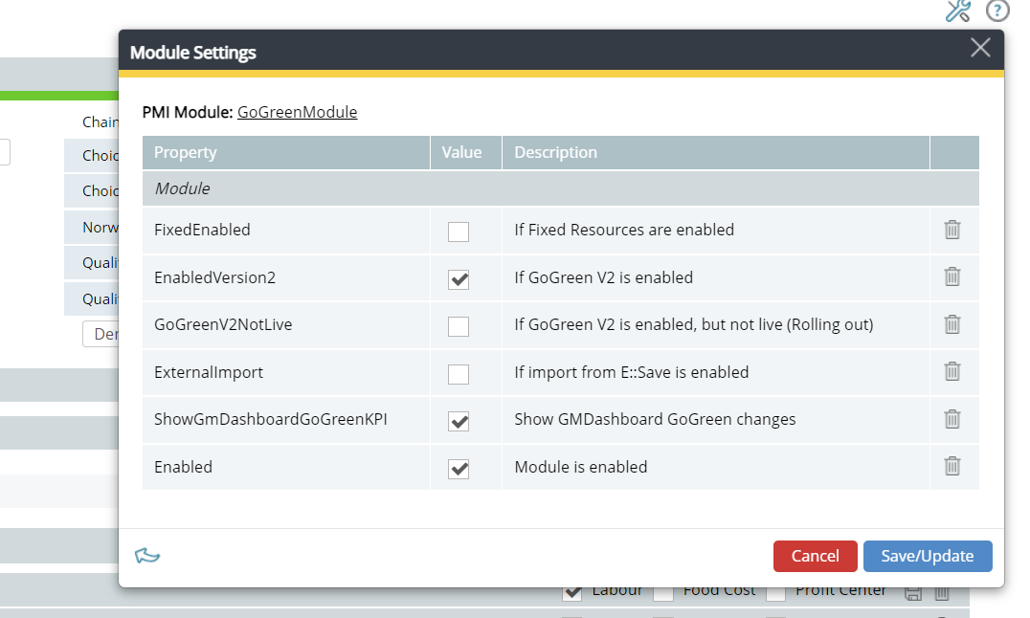
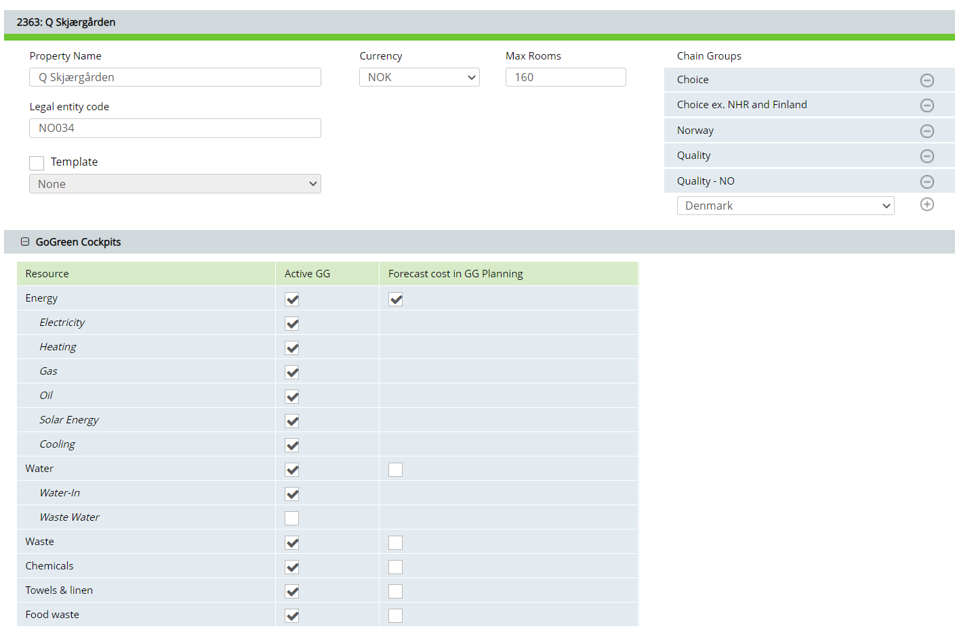
STEP 1 Hierarchy setting
Configuration – Hierarchy setting
Step 1. Activate GG in the module setting
1. Enable “EnabledVersion2” = PMI GG new version is activated
2. Enable/Deactivate “GoGreenV2NotLive” when the user should see GG in PMI (activate this one when Go Live)
3. Enable/Deactivate “Show GMDashboard GoGreen Changes” when the user should see GG in PMI Daily Digest (activate this one when Go Live)
4. Enable when you start setup GG on a property
Step 2. Activate GG cockpits and resources
1. Activate/deactivate the cockpits/resources you would need

Slide 6
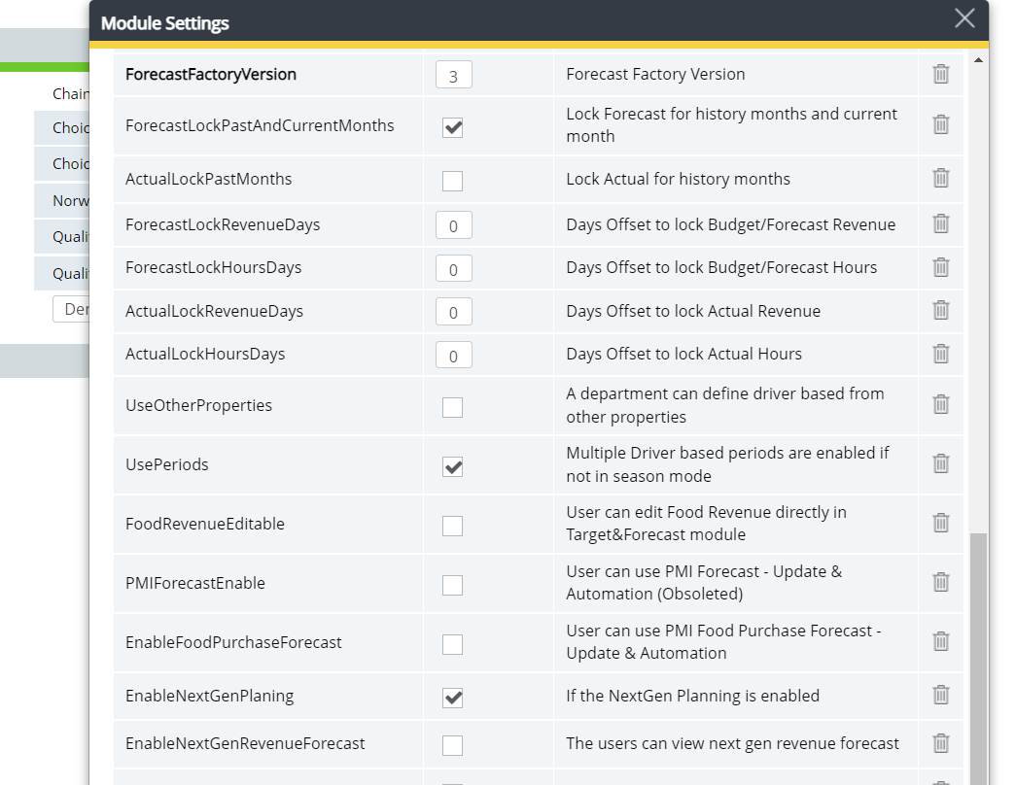
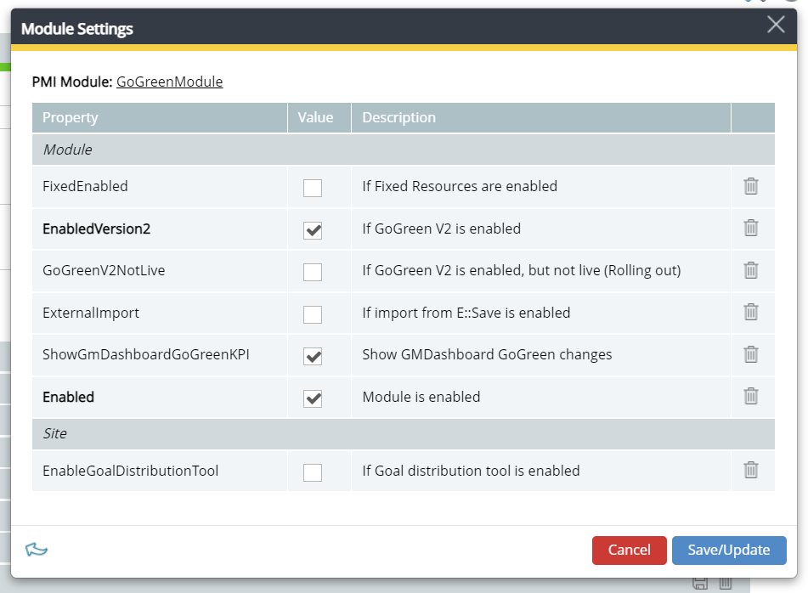
STEP 1 Hierarchy setting
Configuration – Hierarchy setting
Step 3. Activate NextGen Planning
1. Activate “EnableNextGenPlaning” in the module setting “BudgetandForecast module”
Step 4. Activate Goal Distribution
1. Activate the Goal Distribution on the chain level, GoGreen module setting

Slide 7
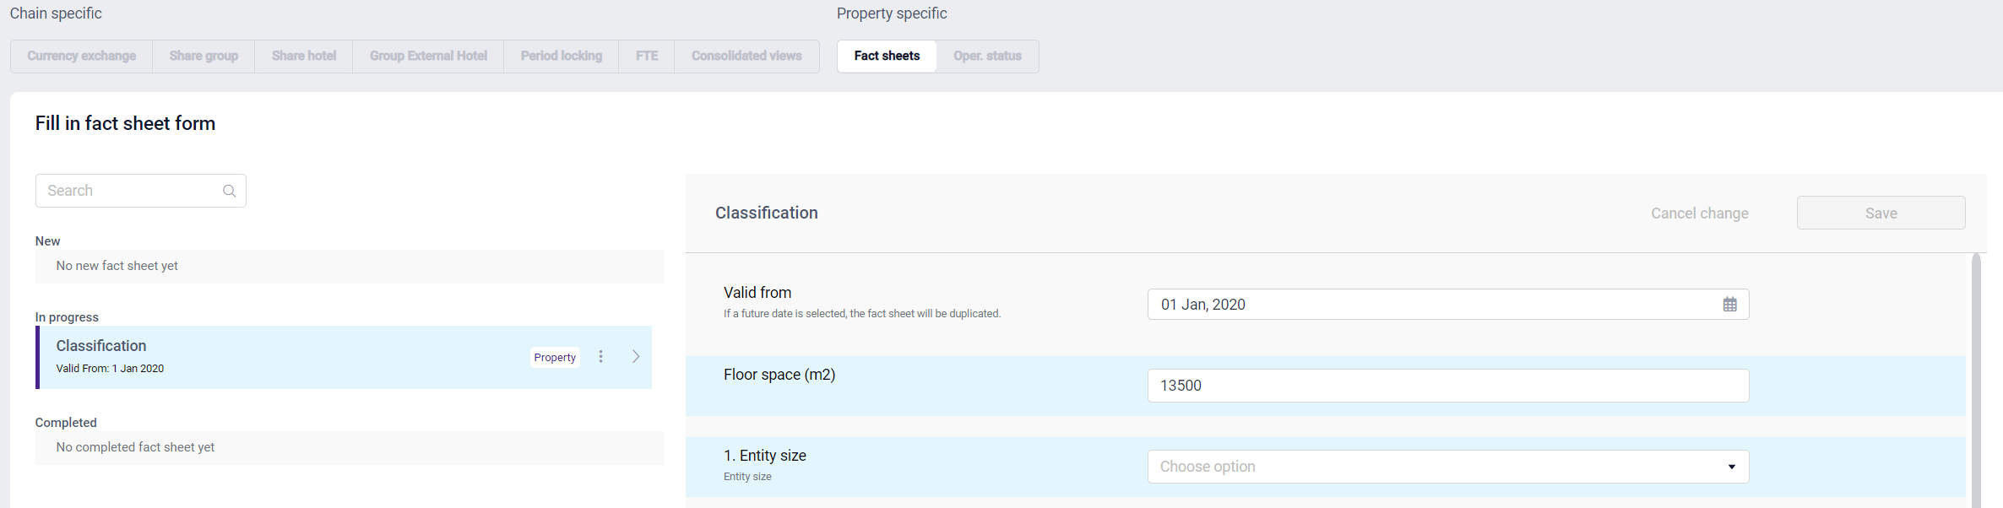
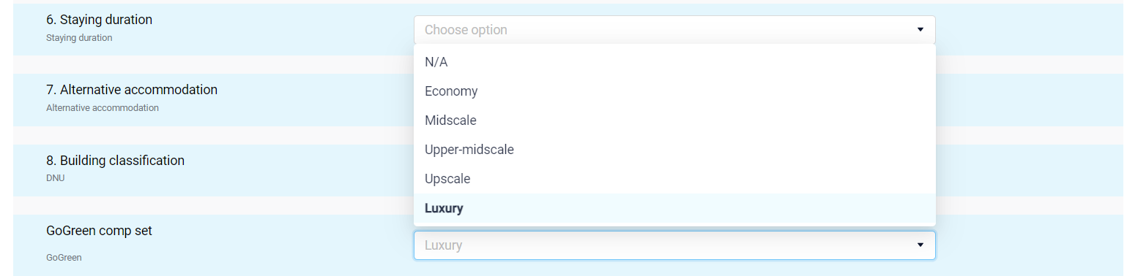
STEP 2
PMI setting
Configuration – PMI settings
To have the KPI resource per Sqm in GG Learning and Benchmarking groups activated in the Goal Distribution, the Sqm mater and Comp-set data would need to be entered in the Factsheet
Step 1. Prep fact sheets
Enter the Sqm mater data in the Fact sheets
Choose a group name from the dropdown list under “GoGreen comp-set.”
PMI Configuration is now complete

Slide 8
Step 3
Data integration
Data integration – General info
PMI GoGreen data & insights
Energies
They are all related to the heat and lighting of the building.
CO2 factor is either from the supplier or country specific per resource
Water
Total water usage of the building
No CO2 emission
Food waste
Food waste generated in the kitchens is either picked up by the waste supplier or measured by a food waste solution, Winnow, eSmiley, etc…
CO2 factor is either from the supplier or country specific per resource
General waste
Is waste generated in the building per fraction.
CO2 factor is either from the supplier or country specific per resource
The supplier will provide waste disposal methods (if required).
Towels & linen
Are units purchased or delivered by the supplier and used to set the rooms (exclude other types of T&L fractions)
CO2 factor is either from the supplier or country specific per resource
Chemicals
Are the KGs purchased or delivered by the supplier for cleaning the rooms
No CO2 emission
- If the client is using Ecolab or Diversey, it is recommended to have chemicals imported; for smaller suppliers, it can be challenging to capture the data

Slide 9
Step 3
Data integration
Data integration – Integration
PMI GoGreen data specification
Energies
Source type: Electricity, District heating, Gas, Solar, Oil, Cooling
Source units: kWh
Format supported: Hourly, Daily or Monthly values
Integration: Email integration (Excel/CSV file format), API, SFTP
Export file: The export file must contain the following: Property name, Date (time for hourly values), Source type, Units
CO2 factor: KG per kWh, Gams per kWh, Ton per MWh
Water
Source type: Water
Source units: M³ or Liter
Format supported: Hourly, Daily or Monthly values
Integration: Email integration (Excel/CSV file format), API, SFTP
Export file: The export file must contain the following: Property name, Date (time for hourly values), Source type, Units
Food waste
Source type: Food waste
Source units: KG or Grams
Format supported: Daily or Monthly values
Integration: Email integration (Excel/CSV file format), API, SFTP
Export file: The export file must contain the following: Property name, Date, Source type, Units
CO2 factor: KG per KG waste, Gams per gram waste, Ton per Ton waste
General waste
Source type: General waste
Source units: KG
Format supported: Daily or Monthly values
Integration: Email integration (Excel/CSV file format), API, SFTP
Export file: The export file must contain the following: Property name, Date, Source type, Units
CO2 factor: KG per KG waste, Gams per gram waste, Ton per Ton waste
Towels & linen
Source type: Towels & linen (rooms)
Source units: Units
Format supported: Daily or Monthly values
Integration: Email integration (Excel/CSV file format), API, SFTP
Export file: The export file must contain the following: Property name, Date, Source type, Units
CO2 factor: KG per unit, Gams per unit, Ton per unit
Chemicals
Source type: Chemical usage (rooms)
Source units: KG
Format supported: Daily or Monthly values
Integration: Email integration (Excel/CSV file format), API, SFTP
Export file: The export file must contain the following: Property name, Date, Source type, Units

Slide 10
Step 3
Data integration
Data integration – Suppliers
PMI GoGreen existing integrations
Energies
Norway
Ishavskraft Norway
Fortum
Statskraft
Veni
Metry/Elhub
Sweden
Götheborg energy
Ishavskraft Sweden
Calsio
Metry
Finland
Ishavskraft FI
Metry
Denmark
Energinet-Danmark
Other countries
Metry
Sensorea
Water
SmartVatten
Food waste
Winnow
eSmiley
Towels & linen
Norway
Nortekstil
Sweden/Finland
Rikstvätt
Comforta/LindströmGroup
Denmark
Elis
Germany
Elis
Other
Birchstreet
General waste
Norway
Retura
Sweden
PreZero
Denmark
Berlin
BSR
Brussels
HSM
Chemicals
Norway
Ecolab
Sweden
Diversey
Other
Birchstreet
For new integrations, see the template “New GG integration.”

Slide 11
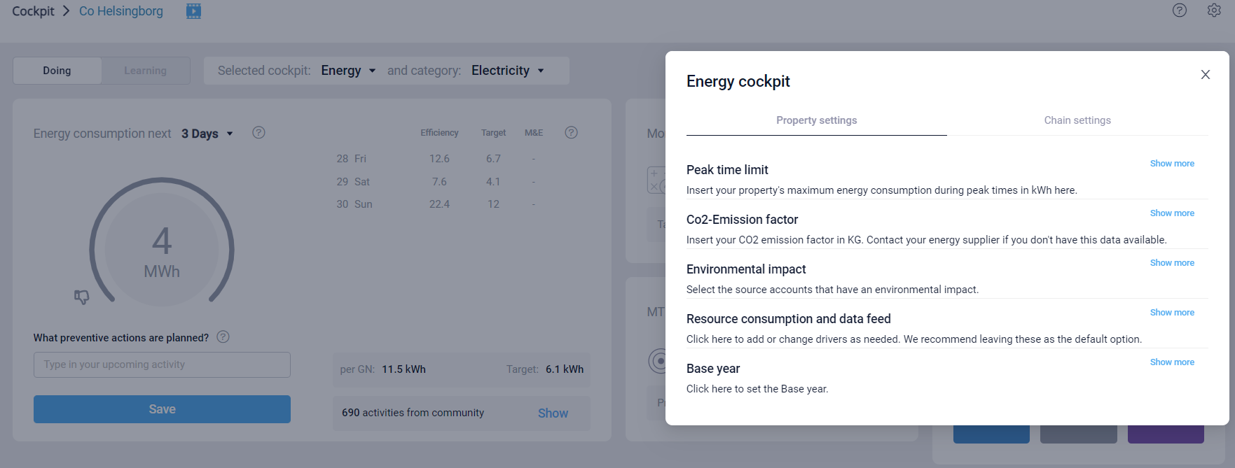
Step 4
Cockpit setting
Cockpit setting
As a minimum setting, you would need to set the base year and enter the CO2 factor to have CO2 emission values in GG Learning and performance measurement compared to base line

Slide 12
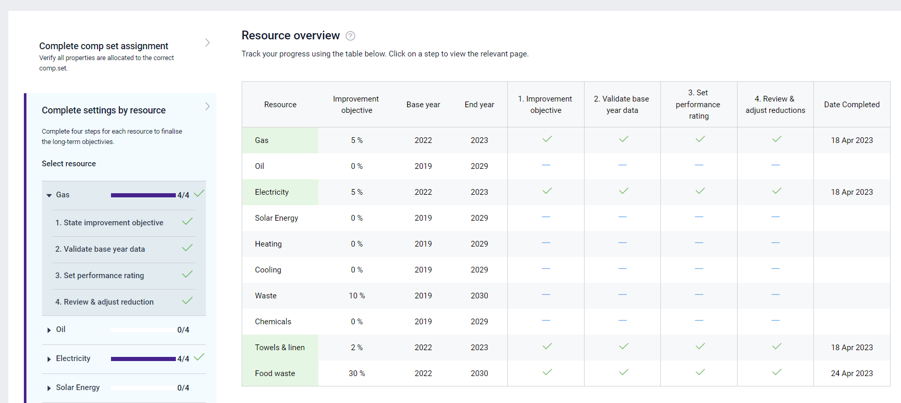

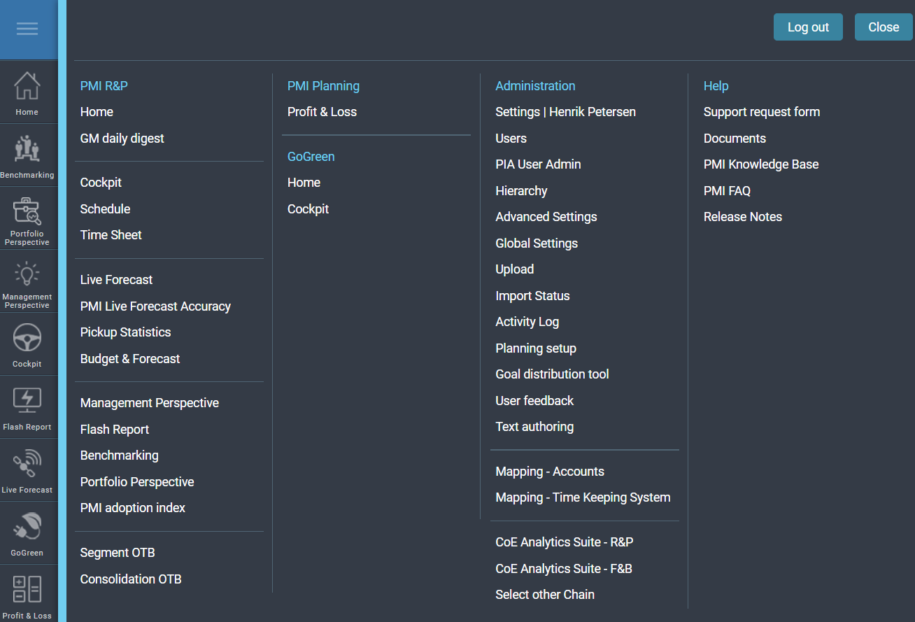
Step 5
Prep
GoGreen
Prep GoGreen - Goal Distribution
Before Go Live, we set up GG with Goals and a target.
100% completeness, so that the user only needs to make adjustments and not start from zero.
Step 1. Create Goals in the Goal Distribution
Go to the navigation list, select Goal Distribution
Select “Complete settings by resource”
Click to enter the objectives
Step 2. Set goal
Follow the steps and make a reduction for the current year of 5% as an example for min. one resource as reference point

Slide 13
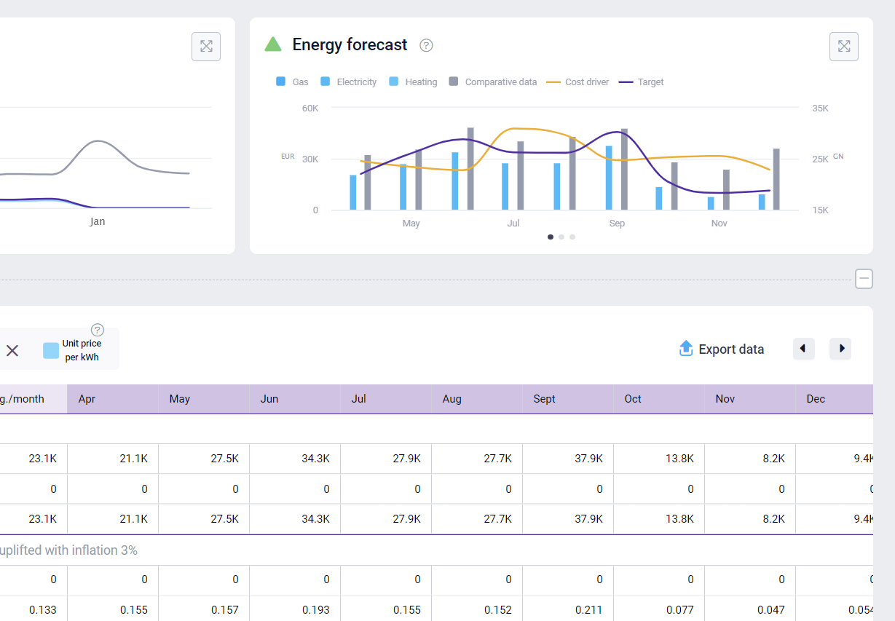
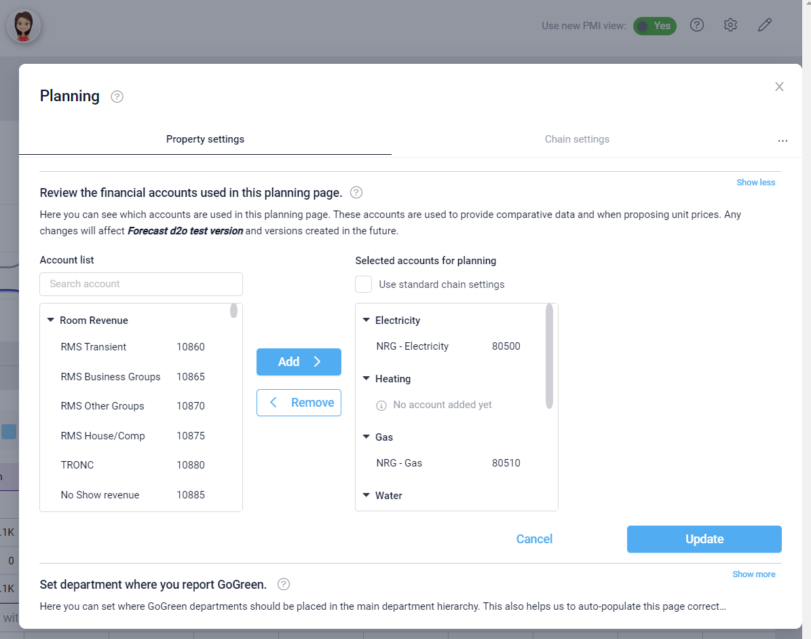
Step 5
Prep
GoGreen
Prep GoGreen - Forecast/Planning setup
Before Go Live, we set up GG with a forecast and submitted it to the cockpit – do not connect to P&L before the client gives you an OK
NOTE – You would need to have a minimum one full year of historical data to use comparative data, if there is no historic, use a black template
Step 1. Create a forecast
Go to the navigation list, select Planning setup
Connect GL accounts under tools
Submit a forecast
PMI GoGreen is now ready to Go Live

Slide 14
Step 6
User onboarding
Go Live/user training – General information
The GoGreen is a self-learning module.
Training sessions are usually a webinar of one hour for cockpit, index and forecast
Training focus: Forecast/Planning
Set the Goal Distribution together with the client first time
Time: 1 hour
Go Live/user training – Invite and Participants
Send out invites to Team sessions 2 weeks before Go Live
Participants
Sustainability manager – GG Owner
General Manager – GG responsible
Controller – Forecast owner
Maintenance – cockpit owner
Head Chef – cockpit owner
Housekeeping – cockpit owner
Front Office - contributor

Slide 15
Step 6
User onboarding
Go Live/user training – Timeline & steps
The GoGreen is a self-learning module.
Training is a webinar one hour
Training focus: Forecast/Planning
An index score of 8+ over a 3 months period
Escalate the case if an index score of 7.5+ is not reached after 3 months
Coaching session
Time: 30 min, all participants
Gather feedback, create a forecast, take steps to be made in the cockpit, and focus on index measurement.
Familiarize yourselves with PMI GoGreen
Period: One month, all participants
Min. requirements; set up one forecast, learn the index measurements and work in the cockpit min 2 times
PMI GoGreen Introduction
Time: 30 min, all participants
Joint agreement on the expectations, responsibilities
desired outcomes and how to achieve them.

Slide 16
Step 6
User onboarding
Go Live/user training - Process flow
Goal distribution
Set objectives
HQ Sustainability manager
Planning
forecast & budget
General manager/Financial director
Curator
Publish & manage tasks to reach the objective
Cockpits
Manage resources
GM Daily Digest
Monitor performance
Doing
Learning
General manager
HQ Sustainability manager
Department manager

Slide 17
Step 6
User onboarding
Go Live/user training - Responsibilities
Role
Tool
Task
When
Time
HQ Sustainability manager
Goal distribution
Set objectives
Monitor, evaluate & learn
One time task
Each 6 month
30 min
30 min
General manager
Financial director
Planning
Create financial forecast
Once a month
5 min
Department manager
HQ sustainability manager
Cockpits
Cockpit tools
Manage resource
Tool setting/CO2 factor
Once a week
Once a year
5 min
10 min
HQ sustainability manager
Curator
Manage and publish tasks
Once a month
10 min

